Slide 1



Slide 2

BACKGROUND
Headquartered in Cleveland, OH
Founded in 1993
Custom Application Development roots
Sitecore Partner since 2008
More than 100 Sitecore Projects
45+ Certified Sitecore Developers
I Work in a Basement in the Chicago Suburbs
Notes:
Paragon Consulting, Inc. is a digital consulting firm based in Cleveland, Ohio. Founded in 1993 as a custom software development shop, Paragon’s early work focused on building custom business applications for local clients like Charles Schwab, Cleveland Clinic, Ernst and Young, Forrest City, Goodyear, Timken and several local medical, legal and financial organizations.

Slide 3


Sitecore MVP
Has been working on Sitecore projects since 2013
Helped deliver websites in industries such as Insurance, Home Building, Legal, Medical and Manufacturing
20+ years of development experience
I like to run and bike.
Rob Reilley
Senior Web Developer

Slide 4
Agenda
What is Data Exchange Framework?
How Can it be Used
Sitecore Setup
Backend Setup
How to Run
Scheduling Data Exchange Framework Batch Jobs
Final Thoughts

Slide 5
What is Data Exchange Framework?
From Sitecore:
Sitecore Data Exchange Framework is designed to facilitate the transfer of data between systems. It allows you to define the logic needed to read data from a source system, transform that data into a format that is compatible with a target system, and write the transformed data into a target system. Developers can build connectors that allow 3rd party systems to serve as source and target systems.

Slide 6
How Can It Be Used?
Importing Data from One Source Into Sitecore (example rss feed, reddit feed etc…).
Exporting Data from Sitecore into Another System (external SQL tables)
Reading and Processing xDB contacts.
Anything data related. The possibilities are endless.

Slide 7
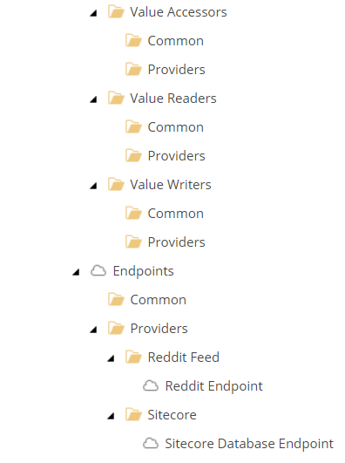
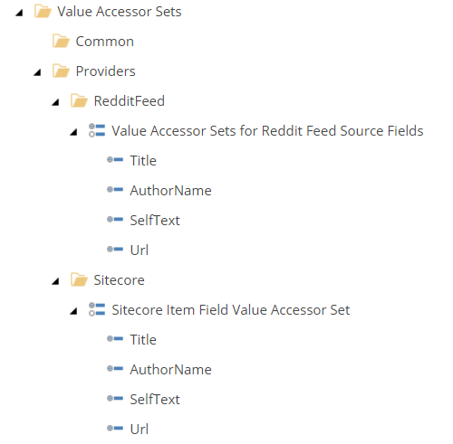
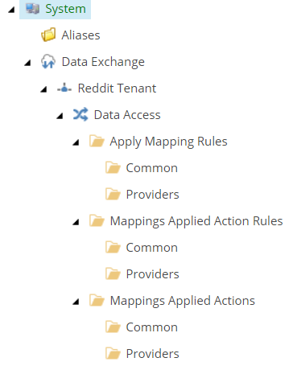
Sitecore Setup

Slide 8
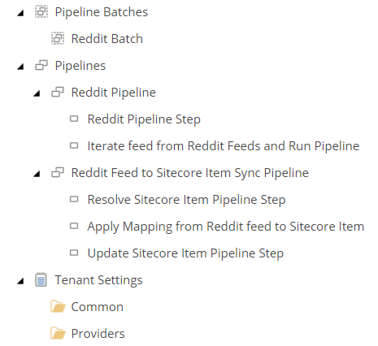
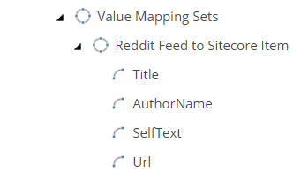
Sitecore Setup Continued

Slide 9
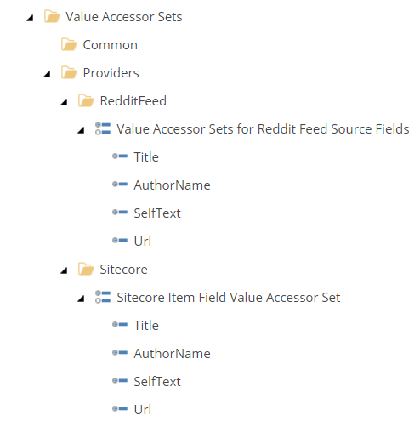
Sitecore Setup - Value Accessor Sets
Used to map field values from the source (Reddit).
Used to map source values from Sitecore.

Slide 10
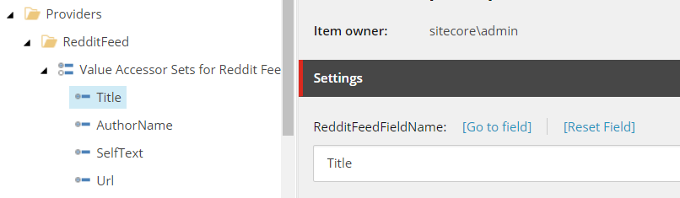
Sitecore Setup - Value Accessor Continued
Each Accessor set has a field. I made these fields the same names I was getting from the feed. It made things a little easier to remember.

Slide 11
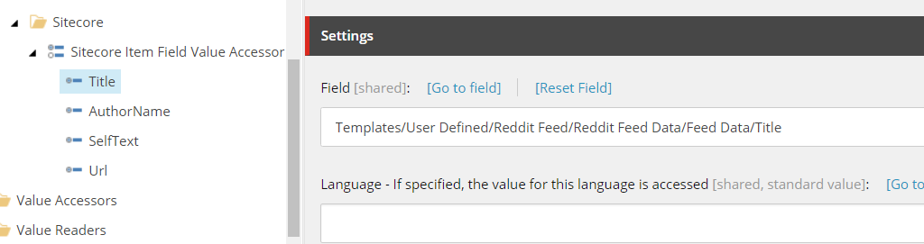
Sitecore Setup - Value Accessor Continued
For the Sitecore field you will use the fields of a template you create. In this case it will be a Reddit item template.
The field value is going to point to the item template of the Reddit feed item. I kept the field naming consistent with the feed.

Slide 12
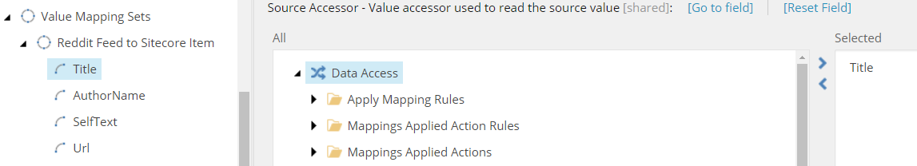
Sitecore Setup - Value Mapping Sets
To bring those together we will use a value mapping set. This will make the connection from the Reddit feed field to the Sitecore field. In this example Title of the Value Accessor Set for the Reddit feed chosen.

Slide 13
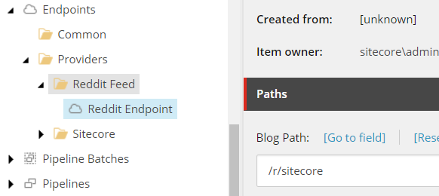
Sitecore Setup - Endpoints
In this example created a template that contains settings needed for the field. Template inherits from the endpoint base template. For the Sitecore endpoint I created and used the default values.

Slide 14
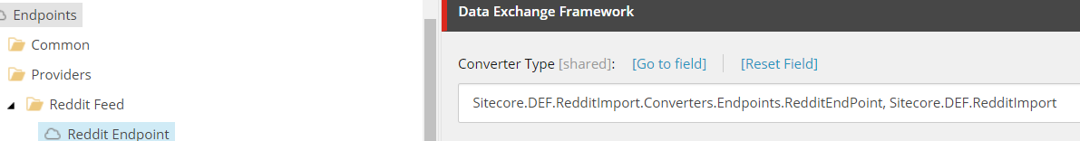
Sitecore Setup – Endpoints Continued
The converter type points to a created method in the code behind. The method is used to retrieve the blog path.

Slide 15
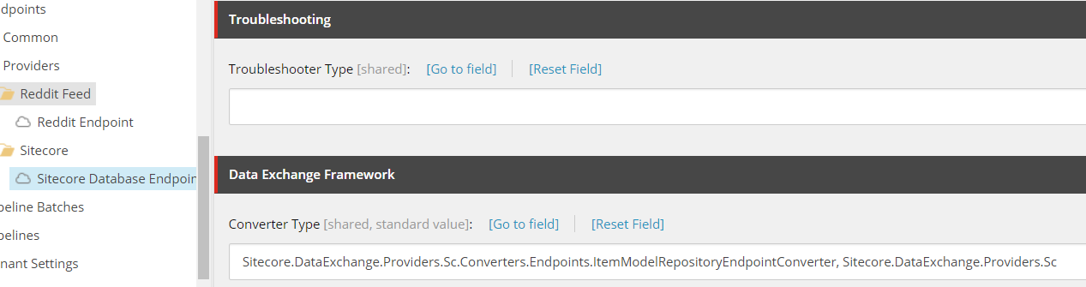
Sitecore Setup – Endpoints Continued
Sitecore Endpoint example (defaulted values):

Slide 16
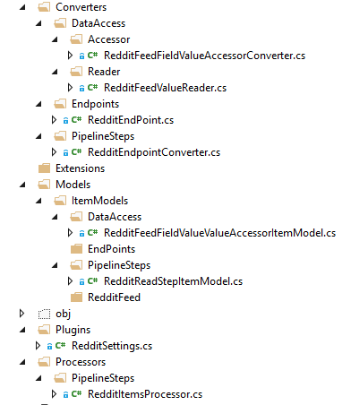
Backend Setup - Overview
This is a snapshot of each folder that was created and the corresponding class file.

Slide 17
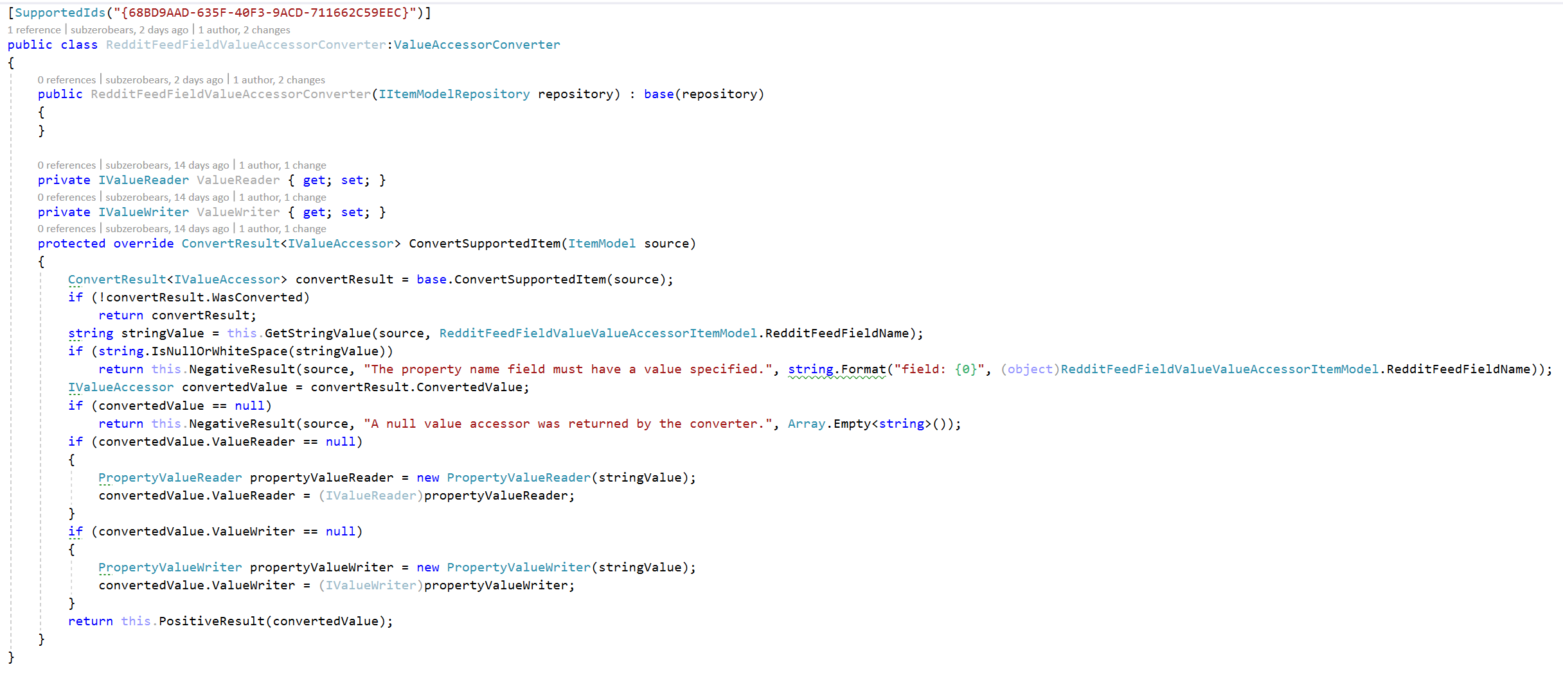
Backend Setup
RedditFeedFieldValueAccessorConverter.cs

Slide 18
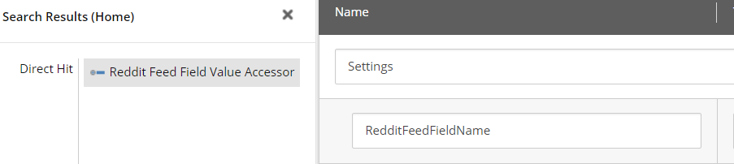
Backend Setup – Converter - Continued
The TemplateId ({68BD9AAD-635F-40F3-9ACD-711662C59EEC}) being set refers to the following template. This template inherits from the Value Accessor template installed by the DEF package.

Slide 19
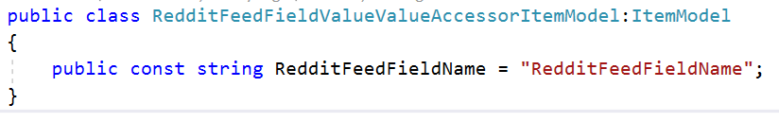
Backend Setup – Converter Continued
So how this corresponds to Sitecore is simple. A Value Accessor Set item is created and the items underneath it use this template. In the RedditFeedFieldValueAccessorConverter class it is setup to get the value of that field using the combination of the template and the field name defined in the RedditFeedFieldValueValueAccesorItemModel. You will see how this is tied in to other parts of the DEF process as we go along.

Slide 20
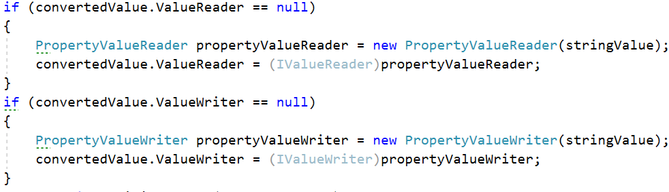
Backend Setup – Converter Continued
In the code you will notice a ValueReader and a ValueWriter are set. The ValueReader is used to read in the feed and match the fields for each Reddit blog item. The field definition is contained in the stringValue. The ValueWriter defines a new PropertyValueWriter class. That class is part of the DEF and used to convert the field values. (This code was changed in 2.1 versus previous versions so you might see this done differently).

Slide 21
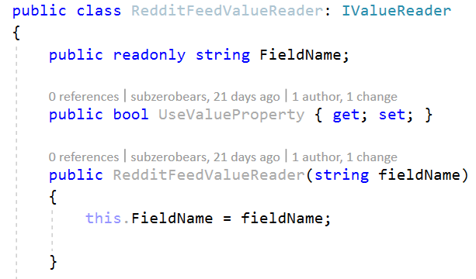
Backend – Value Reader
RedditFeedValueReader.cs
This class will process the Reddit Post item and match field name with value. Title, AuthorName, SelfText etc… are field names in the Reddit feed. I believe you can name these differently, but I prefer to keep the same name as it is in the Reddit post item.

Slide 22
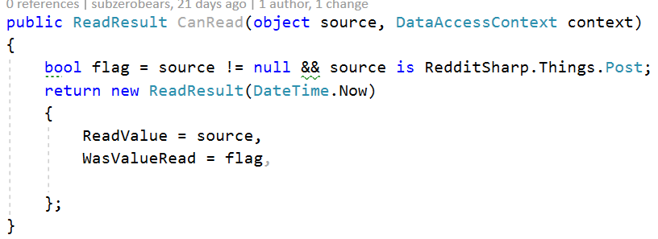
Backend – Value Reader Continued

Slide 23
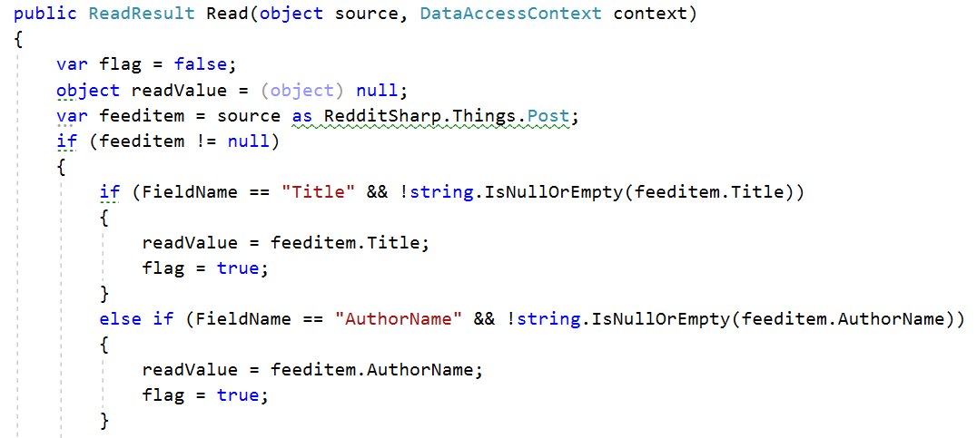
Backend – Value Reader Continued

Slide 24
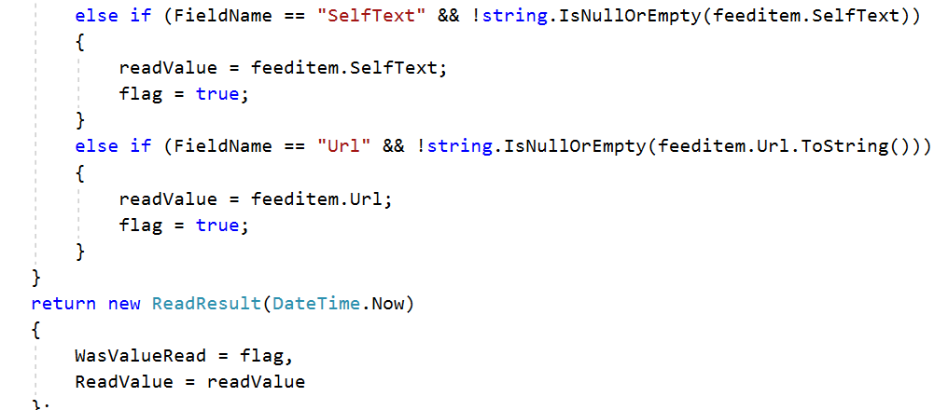
Backend – Value Reader Continued

Slide 25
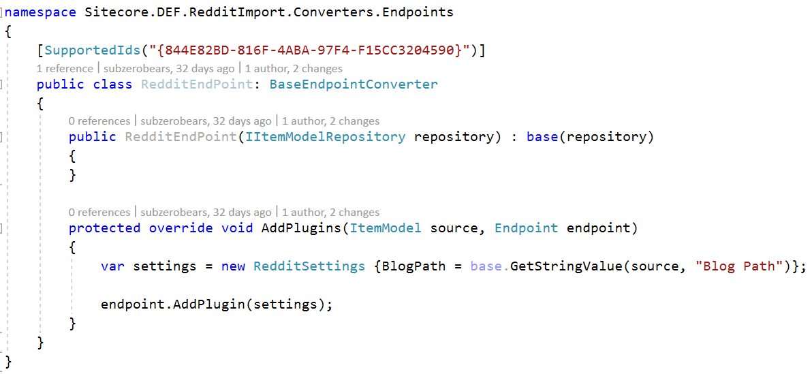
Backend – End Point
RedditEndPoint.cs
The Reddit End Point will have the information for the Blog Path in Reddit. The TemplateId defined points to the RedditEndPoint template. Settings are returned and added to the plugin. The plugin is required to be implemented by the pipeline converter and processor.

Slide 26
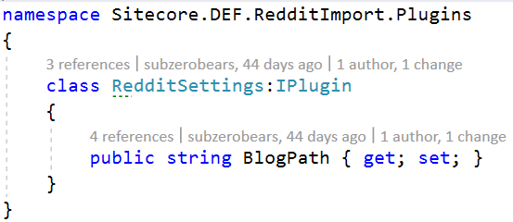
Backend – End Point - Continued
This is the model plug in code:

Slide 27
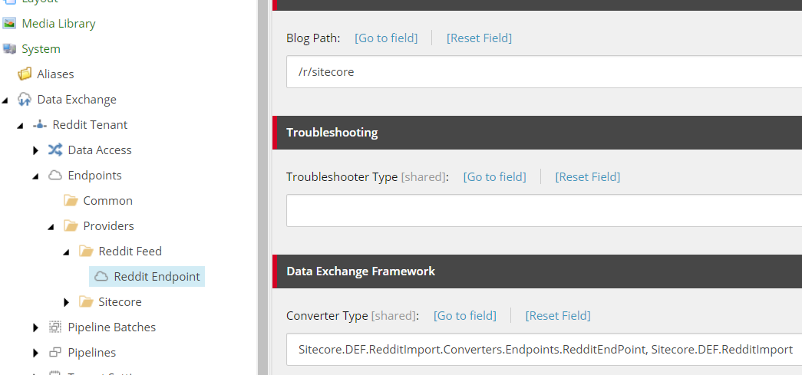
Backend – End Point - Continued
This is values of the Reddit Endpoint. You can see that the Converter Type points to the RedditEndPoint class.

Slide 28
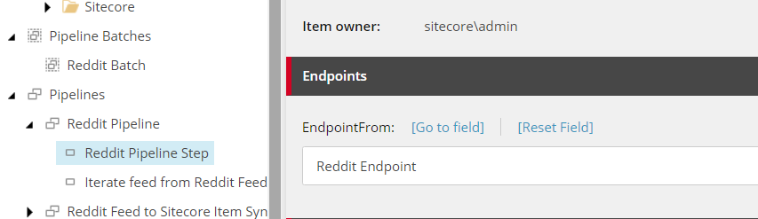
Backend – End Point - Continued
More about this later, but as you can see in the Reddit Pipeline Step the Reddit Endpoint is selected. Now you can see how this all ties together.

Slide 29
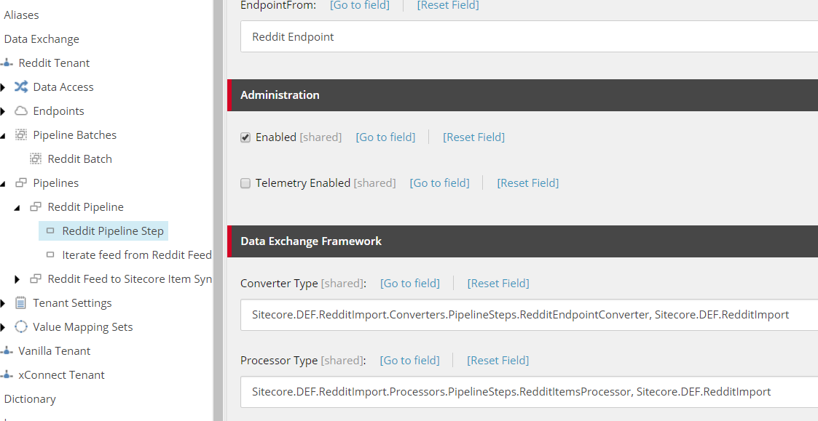
Backend – End Point Converter - Continued
Looking in Sitecore you can see where they Converter Type points to the Endpoint Converter and also the Processor Type which will get called and receive the end point information and do the Reddit Feed processing.

Slide 30
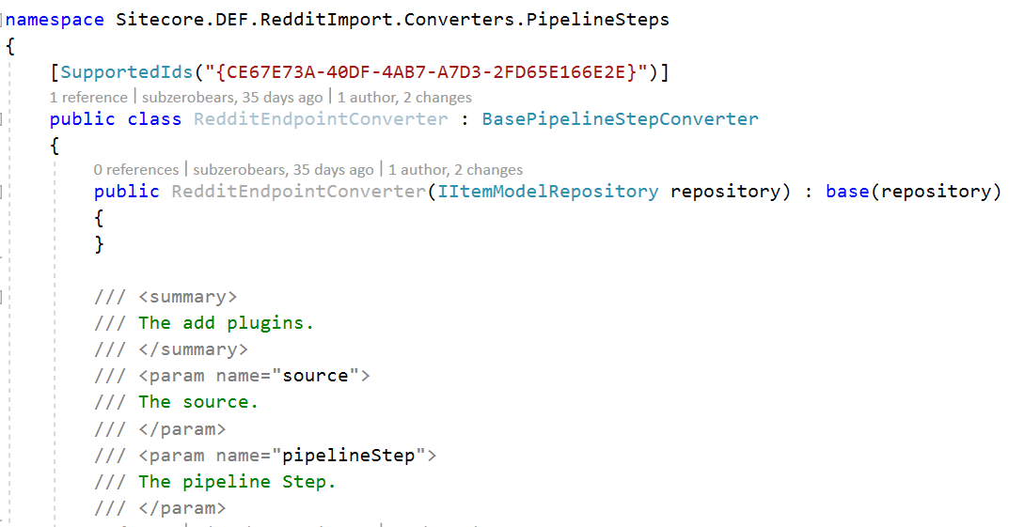
Backend – End Point Converter
RedditEndPointConverter.cs
The converter is one of the most crucial parts of the DEF. This is what ties together the pipeline step of the DEF. The SupportedIds value is the template id of the Reddit Pipeline step. As you can see the endpoint settings are passed in to the pipeline step (next slide).

Slide 31
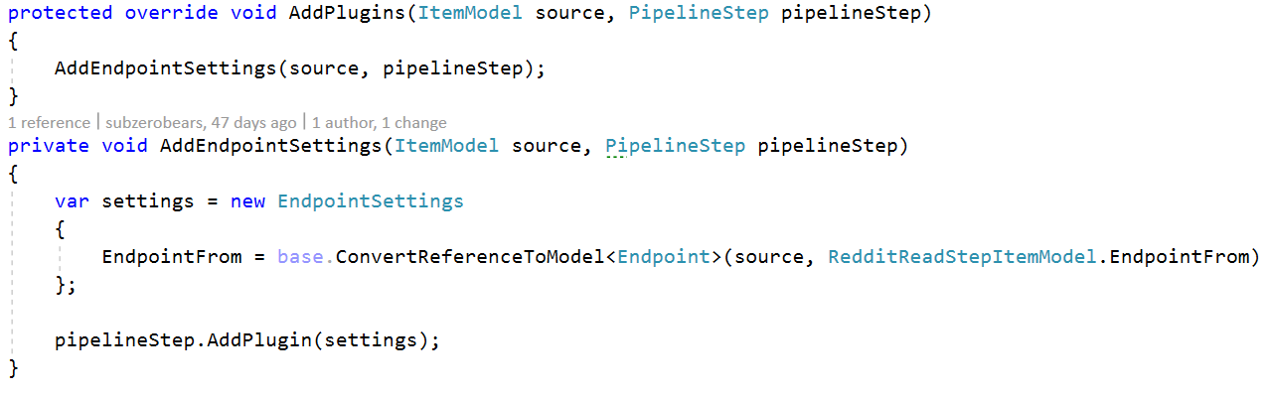
Backend – End Point Converter - Continued

Slide 32
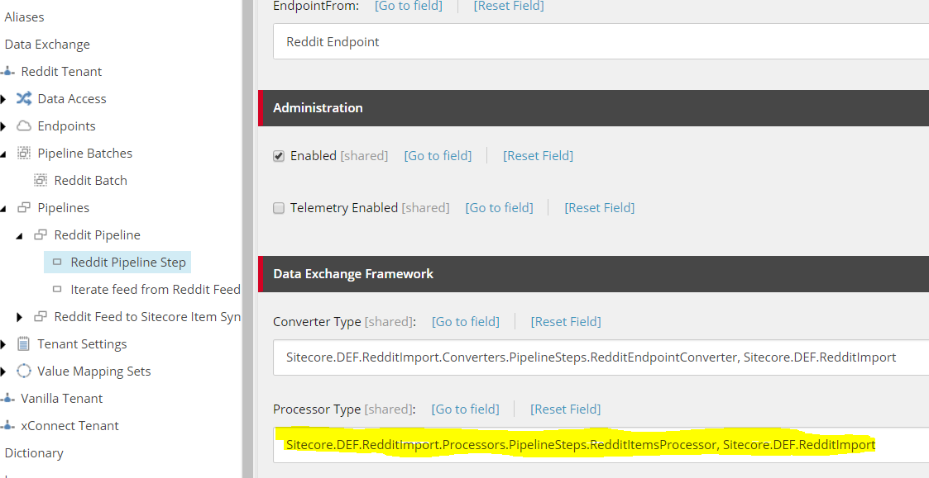
Backend - Processor
RedditItemsProcessor.cs
In Sitecore under Pipelines\Reddit Pipeline\Reddit Pipeline Step you will see under Processor Type the RedditItemsProcessor defined.

Slide 33
Backend – Processor Continued
The next set of slides show the code for the processor. You will see that the Required EndpointPlugin is defined for RedditSettings.
Endpoint, PipelineStep and PipelineContext should all have values at this point. As you will notice the ILogger parameter is used to set up any custom logging.
If you look at the method RedditFeed, what that does is create a new Reddit class using RedditSharp. It then uses the blogpath setting from the endpoint to retrieve the blog feed.
A collection of reddit feed blogs is then created. It will use fieldnames we defined earlier to match the Reddit feed fields to the fields defined for the new Reddit Sitecore item.

Slide 34
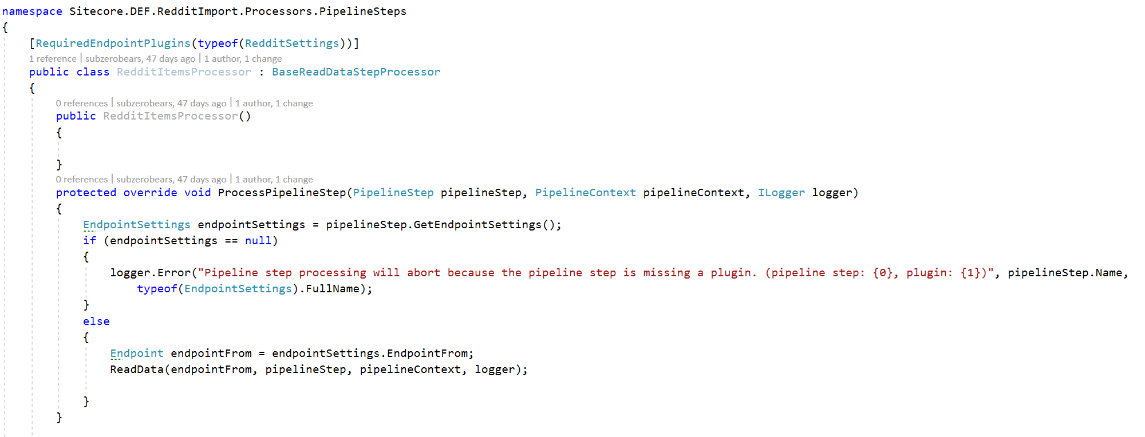
Backend – Processor Continued

Slide 35
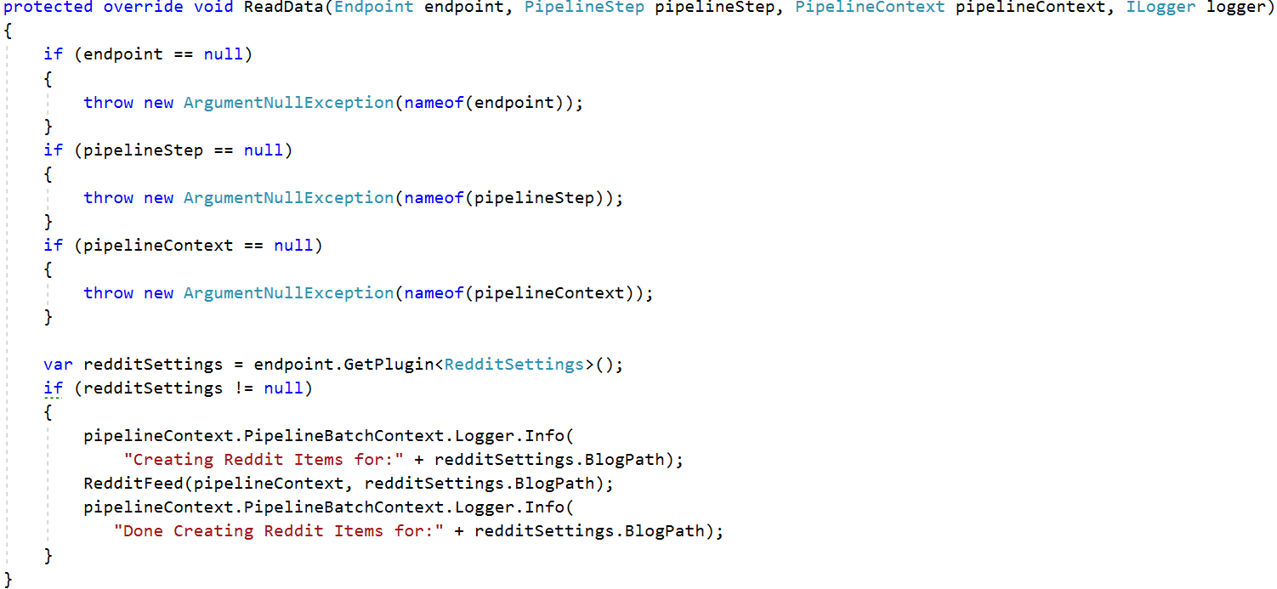
Backend – Processor Continued

Slide 36
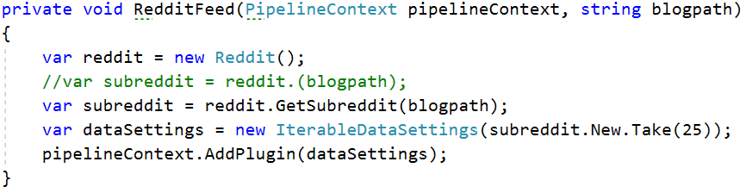
Backend – Processor Continued

Slide 37
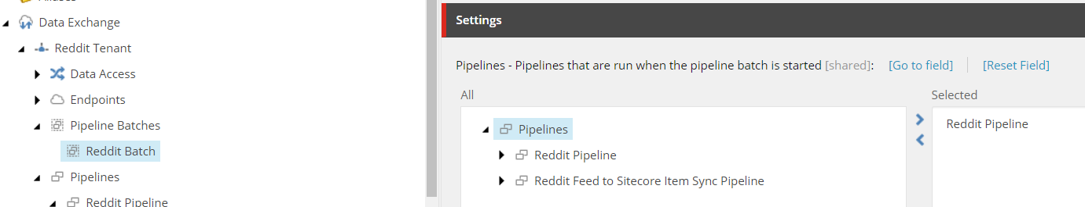
How to Run
Below you will find a Pipeline Batch that was created to run all the necessary steps to process and import the data into Sitecore.

Slide 38
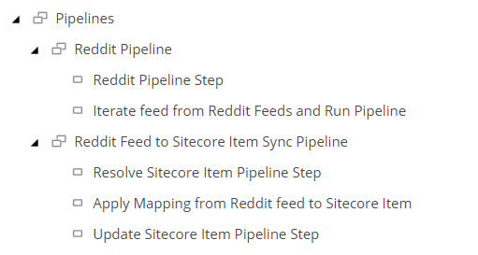
How to Run Continued
Below are the steps that get run under Pipelines. You can also see above that the Reddit Pipeline is selected. (Show Steps)

Slide 39
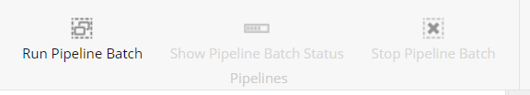
How to Run Continued
When you first click on the Pipeline Batch you will notice a group of buttons on the ribbon. If something is not correctly setup these buttons will be disabled. To run the Pipeline Batch just click on the Run Pipeline Batch button.
While it is running the button will grey out and you will see the Stop Pipeline Batch button enabled. After it is finished running the Run Pipeline Batch will be enabled again.

Slide 40
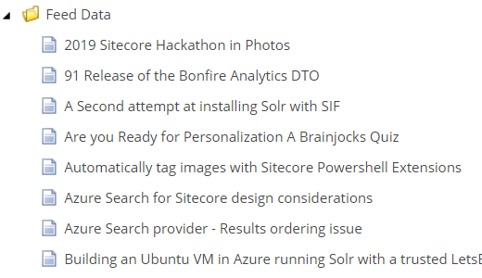
Results

Slide 41
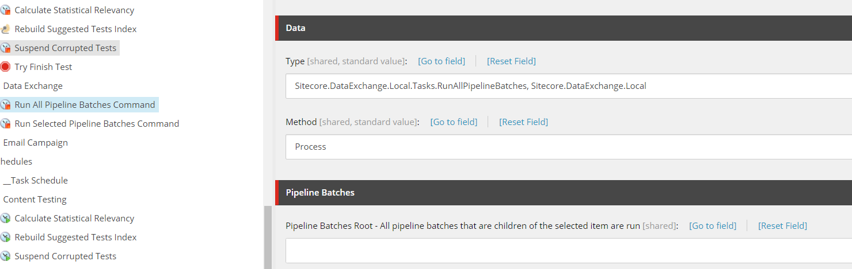
Scheduling DEF Batch Jobs
Run All Pipelines Batches Command

Slide 42
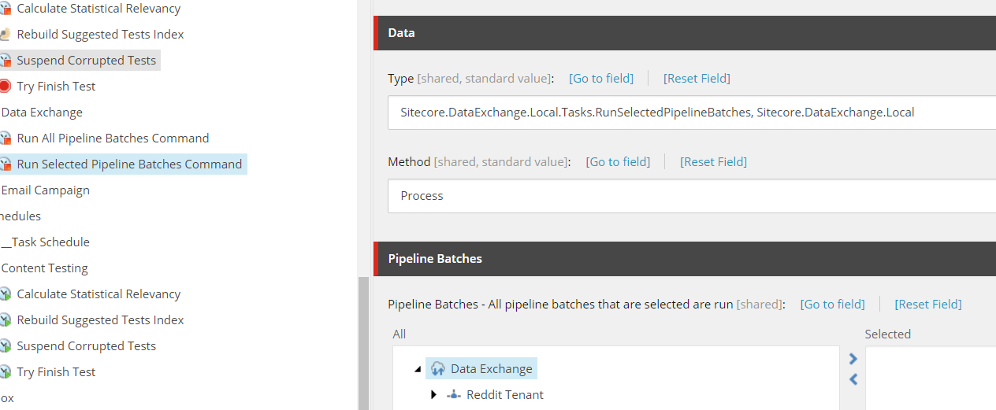
Scheduling DEF Batch Jobs
Run Selected Pipeline Batches Command

Slide 43

Final Thoughts
The Data Exchange Framework should always be considered when importing/exporting data in Sitecore.
It does not completely replace tools such as RAZL as the process would be more manually intensive.
The possibilities are endless.

Slide 44
Additional Resources
Sitecore:
https://doc.sitecore.com/developers/def/20/data-exchange-framework/en/data-exchange-framework.html
https://marketplace.sitecore.net/Modules/R/Reddit_Blog_Importer.aspx?sc_lang=en
Other Sources:
https://sitecorerunner.com/category/data-exchange-framework/

Slide 45


QUESTION & ANSWER

